Slide 1


Fundraising 101
Hazel Erickson

Slide 2
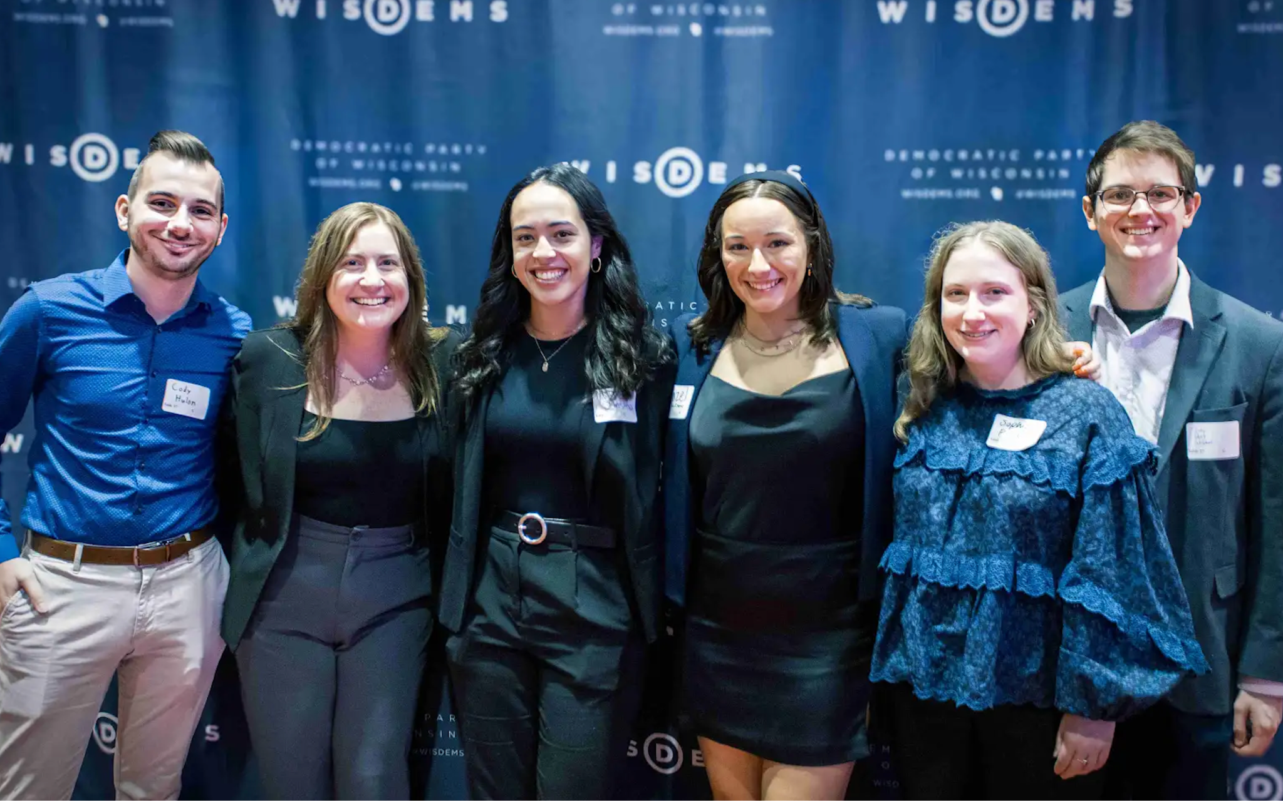
Hazel (she/hers)
Deputy Finance Director of the Democratic Party of WI
Call Time Manager, Finance Assistant, Intern
Field Organizer, Biden ‘20
Intern, Rep. Betty McCollum
Graduated from UST in ‘20 with triple major, minor

Slide 3

Fundraising 101
Overview
Finance Team Structure
Fundraising Tools
Donor Relationships
Q&A

Slide 4
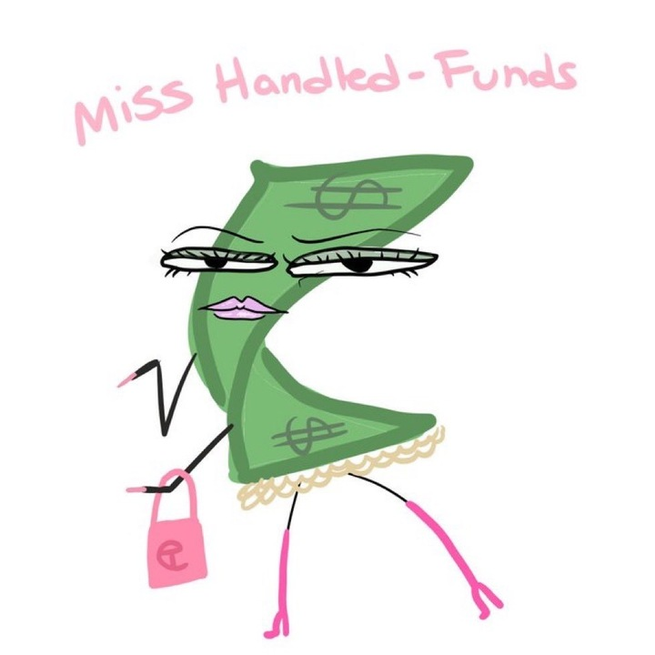
Introduction to Finance
$$$ is up in campaigns!
No money, no campaign
Finance is the foundation of campaigns
Finance Job
Raise when needed
Raise money cost-effectively
Raise in strict accordance of the law

Slide 5
Finance Team Structure

Slide 6

Finance Director
Deputy Finance Director
Call Time Manager Events Manager
Finance Assistant Finance Assistant
Finance Intern(s)

Slide 7

Finance Consultants
PAC Consultant
Finance Advisor
State Specific Donor Consultant
National Donor Consultant

Slide 8
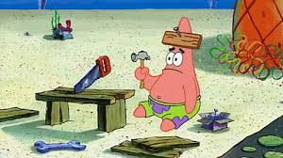
Fundraising Tools

Slide 9
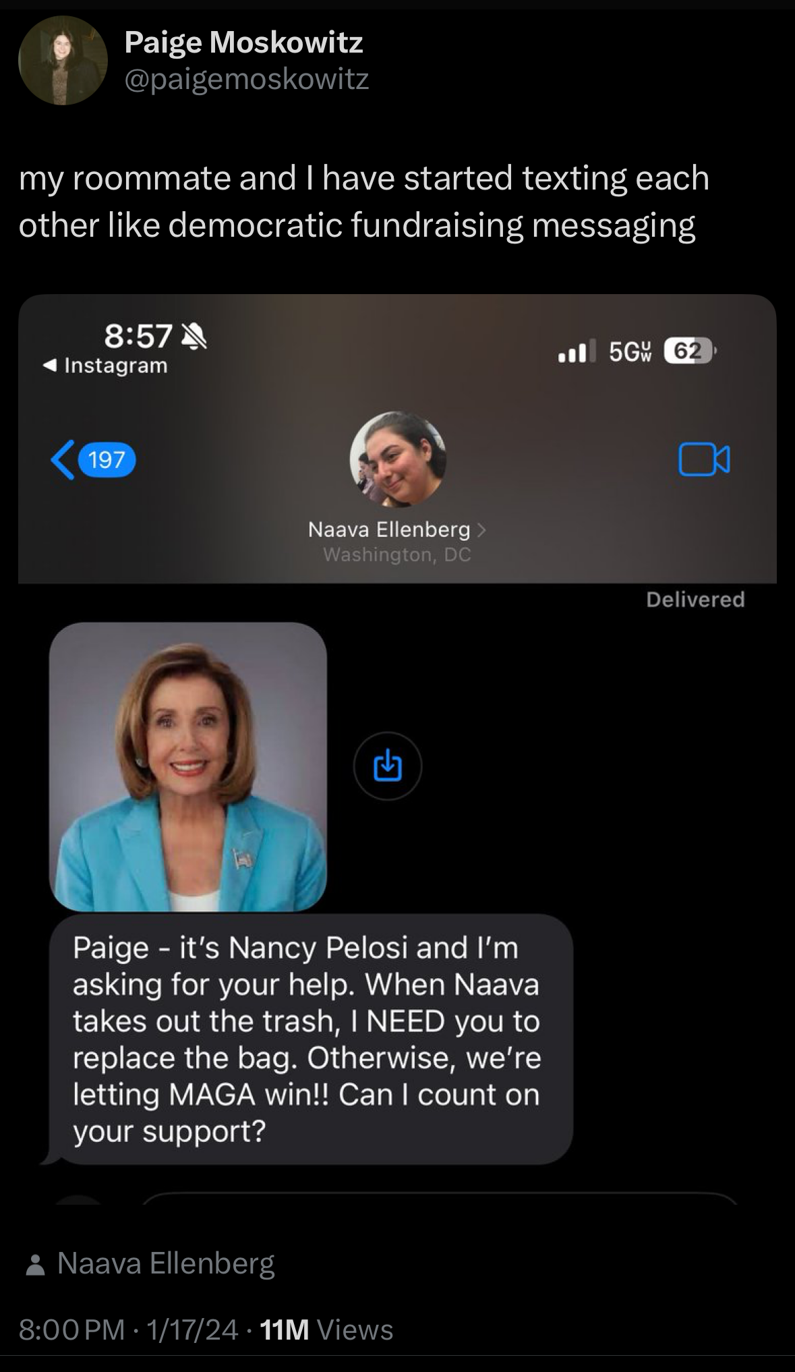
Digital
Email, social media, website, etc.
Smaller dollar donations
Quick turnaround - reactive!
Persuade a mass audience to donate to your candidate
Primarily managed by the digital team (sometimes the finance team!)

Slide 10

Mail
Mail consultant
Cold prospect mail
Resolicitation mail
Acquisition to resolicitation

Slide 11
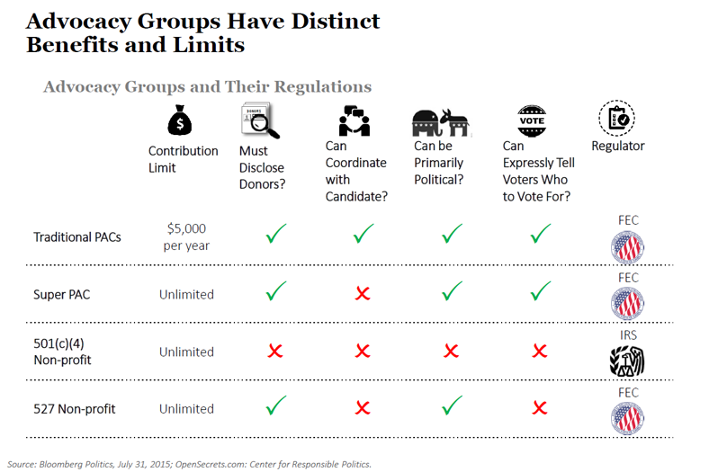
PAC (Political Action Committee)
Most labor groups, corporations, and organizations have PACs
For example AFSCME and Planned Parenthood
Different donor limits than individuals
Super PACs cannot donate to campaigns and parties

Slide 12
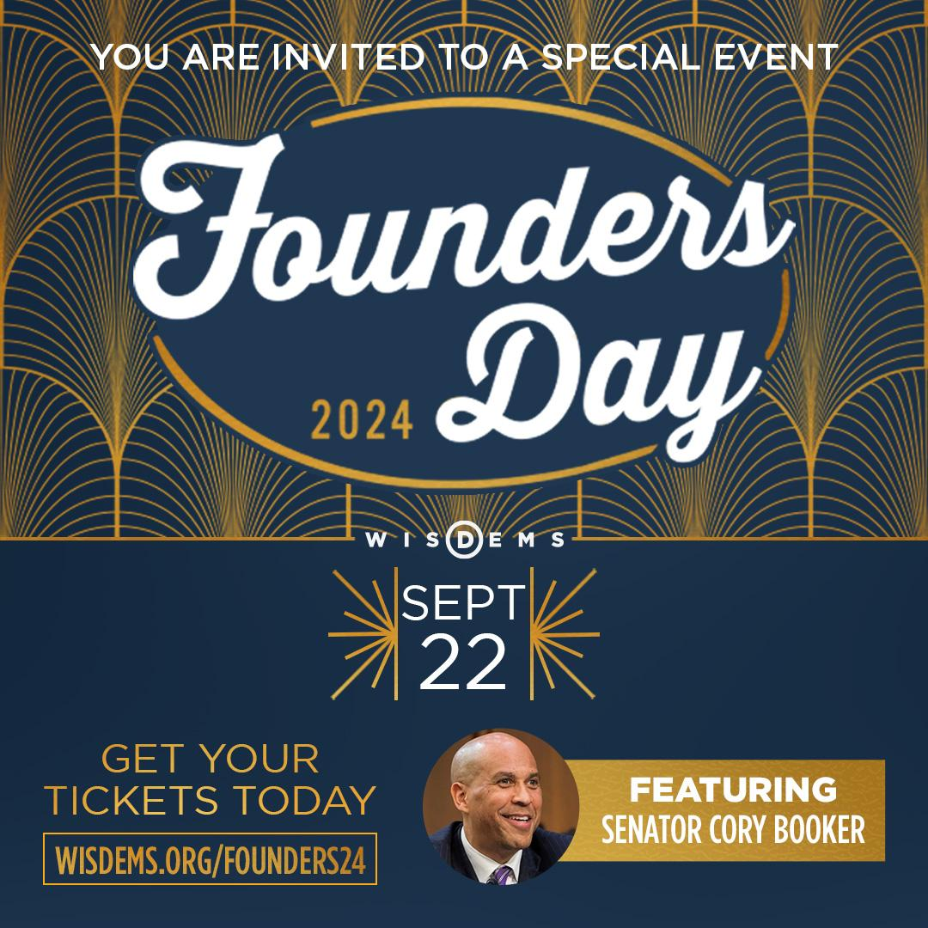
Fundraising Events
Fundraising Events
In-state and national virtual events
A pre-advertised price of admission.
Host committee - raising from personal networks and lists.
Broad range of event sizes, locations, and styles
The purpose of the event is to raise money. It’s a fundraiser, not a party.

Slide 13
Call Time
Call Time Manager
Principal (candidate, Chair) makes direct solicitations
Call time manager / candidate relationship
Hours and travel
Finance Director owns major donor prospects
Other consultants that help with soliciting funds during call time include

Slide 14
Donor Relationships

Slide 15
Why Donors Give
Fundraising IS NOT begging!!
People donate to a campaign/organization because they want to. Their contribution serves their needs—not the party’s, and not the fundraiser’s.
Donors contribute when the fundraiser has identified their needs and demonstrated how they will benefit if the candidate is elected.
The key to developing an effective strategy is understanding the needs, interests, and giving practices of the targeted donors. This will help the finance team tailor an approach, craft and communicate a persuasive message, and determine what level of support to seek.

Slide 16
Donor Relationships
Once you have identified why a you think a donor wants to give, you come up with a strategy to recruit them: Chair call, event invite, meeting with the Chair or staffer
Once they are on board your role becomes maintaining the relationship
Inviting them to events
Being present within the community of donors
Being available at all times
Being their point of contact in the campaign and a source of information
Maintain your professionalism

Slide 17
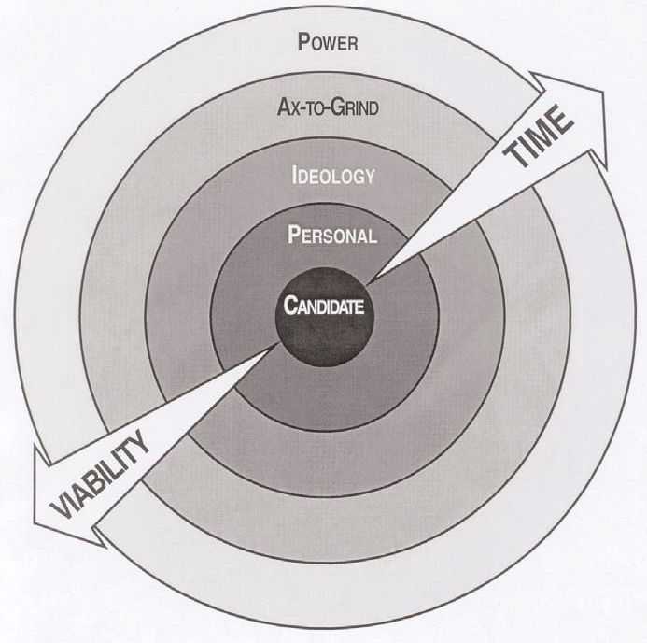
Circle of Benefits
The Circles of Benefit is a system to help fundraisers:
Organize donors.
Understand a donor’s motivation to give.
Set priorities.
The arrows labeled “time” and “viability” illustrate that the further the circles extend from the center, the more a candidate’s political viability becomes a factor in the donor’s decision to give, and the more time must be invested to educate and cultivate donors.

Slide 18
Personal Circle
WHY: Donors in the Personal Circle give because they have a close relationship with the candidate. Loyalty moves personal circle donors to look past differences in ideology and party affiliation, and sustains their support regardless of the candidate’s standing in the polls.
WHO: Personal Circle donors are family members, friends, and close professional colleagues of the candidate.
WHEN: Start with this circle of donors to raise the first operating costs of the campaign. Early support from this circle demonstrates viability to traditional donor sources, the media, community leaders, and other opinion-makers.
NOTES: Soliciting donors in the Personal Circle is the critical first step in a fundraising campaign. This can be a tough circle for the candidate, but her willingness to solicit her Personal Circle demonstrates her commitment to running for office and her ability to build a winning campaign.

Slide 19
Ideological Circle
WHY: Ideological donors give because the candidate is a member of their religious, cultural, or ethnic group. This circle includes donors who share the candidate’s advocacy of a particular cause.
WHO: Ideological donors include pro-choice advocates, environmentalists, civil rights activists, and others.
WHEN: Ideological donors take political risks and participate early to ensure the candidates they support have the strongest possible voice. Ideological donors tend to contribute early in the campaign.
NOTES: Ideological donors give to challengers, candidates running in open seats, and incumbents, but play a particularly important role in challenger and open seat races. Ideological donors understand the difficulties of an uphill battle, since many represent constituencies that have struggled to gain a seat at the table.

Slide 20
Ax-to-grind Circle
WHY: Ax-to-Grind donors give because the opponent’s victory would adversely affect their interests, or has already done so. They have tremendous incentive to weaken your opponent
and strengthen your candidate.
WHO: Anyone who strongly dislikes or fears your opponent.
WHEN: These donors, like those in the Personal and Ideological Circles, can provide early support.
NOTES: Donors in the Ax-to-Grind Circle give to challengers, open seat candidates, and
incumbents.

Slide 21
Power Circle
WHY: Donors in the Power Circle give to protect and advance their economic interests.
WHO: They include business interests, labor unions, political action committees (PACs), and professional associations.
WHEN: Power donors should not be counted on to provide early support, unless the candidate is an incumbent. Power Circle donors tend to give once a candidate has demonstrated viability. The difficulty facing challengers or candidates for open seats is that the Power Circle, which is the largest source of money in politics, is generally unavailable until the final quarter of the campaign.
NOTES: Incumbents receive the majority of Power Circle support. While open seat candidates
are frequently beneficiaries, challengers are unlikely to receive their support until the
candidate’s competitiveness in the race is firmly established. Power Circle donors often contribute
to both sides.

Slide 22
Questions?

