Slide 1

Media Strategies & Training for Candidates
Presented by Amanda Theisen,
Sunrise Banks

Slide 2
What We’ll Cover
Meet Your Trainer
Why is Media Training Important
Today’s Media Landscape
Your Key Messages
Best Practices for:
Different Media Formats
Handling Difficult Questions
Body Language and Delivery
Do’s and Don’t’s
Building Positive Media Relationships
Q&A

Slide 3
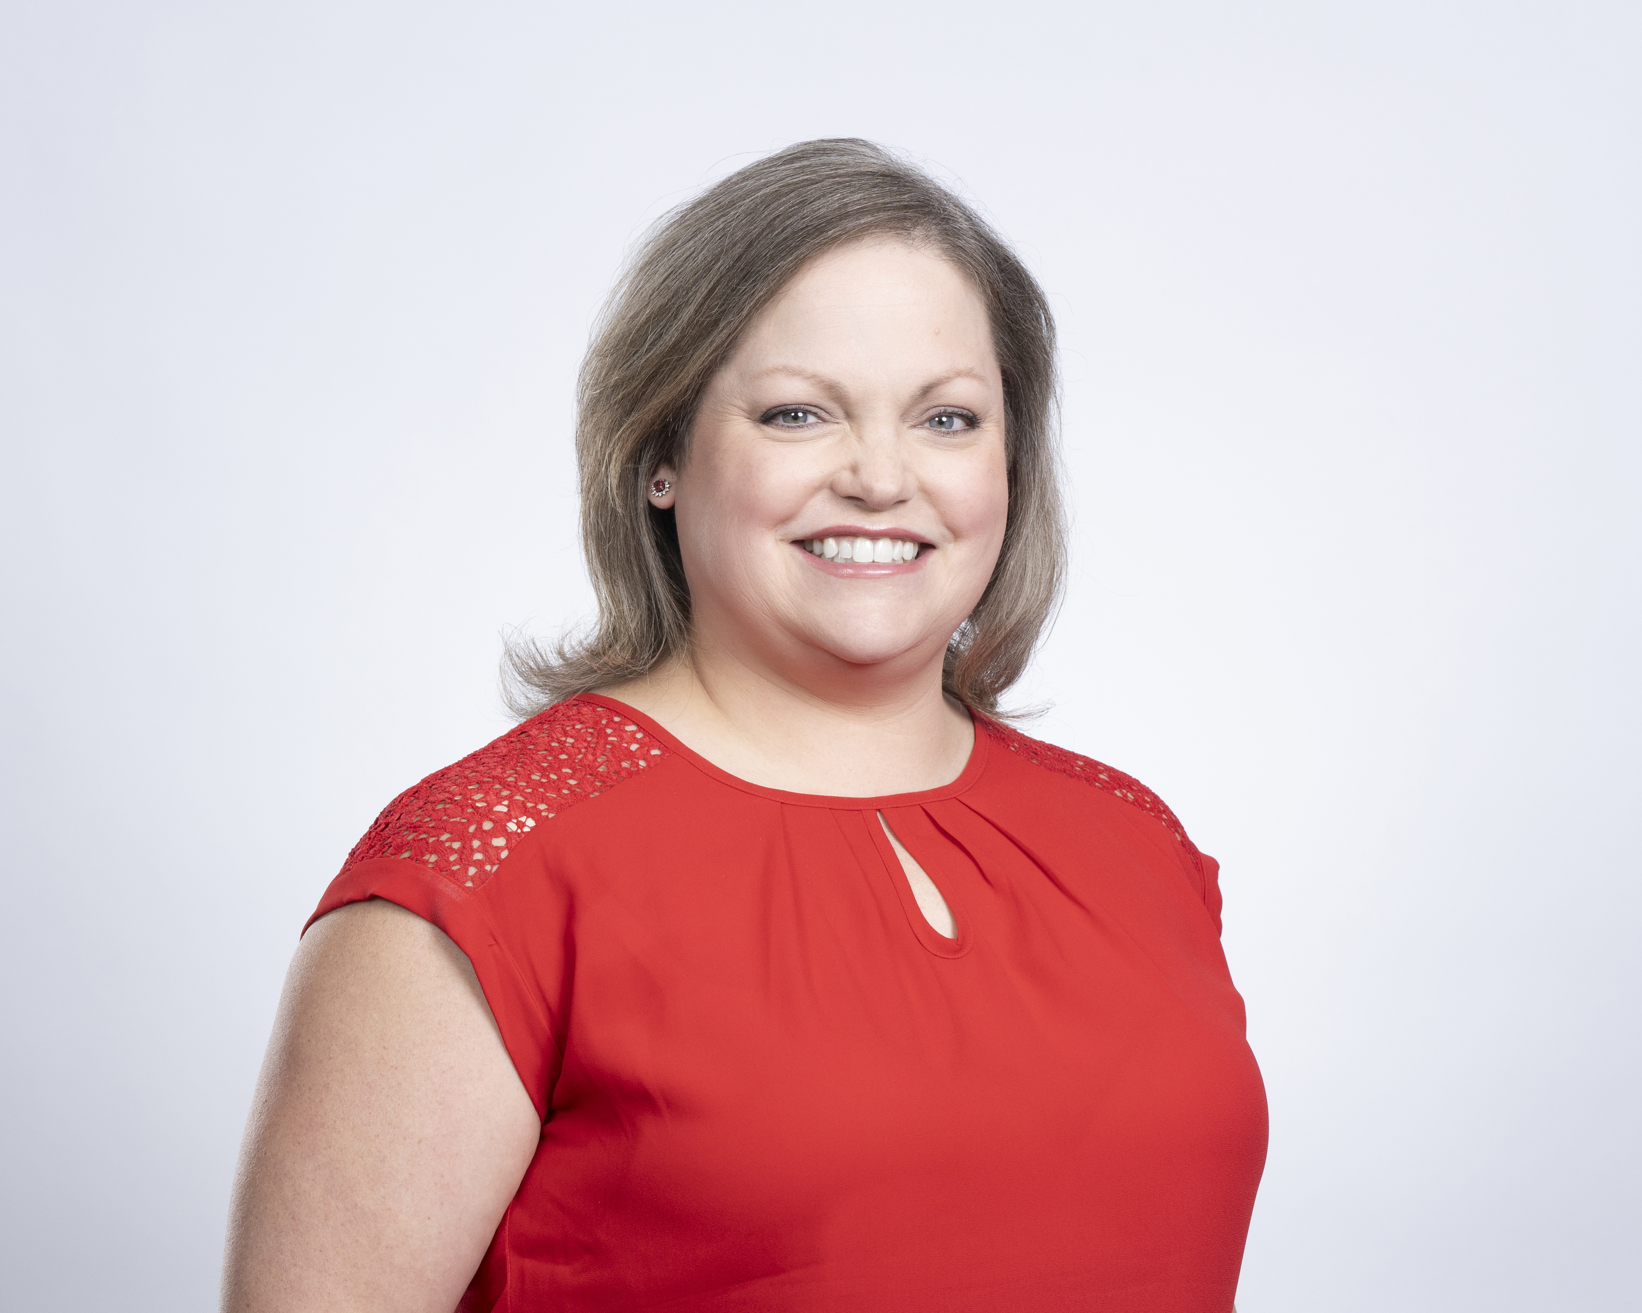
More About Me
I am an award-winning former journalist turned communications/PR professional
I spent 13 years at KSTP-TV as a senior news producer
5 years as executive producer of “At Issue with Tom Hauser”
Produced live election coverage, live and live-to-tape debates
Won four regional Emmys; 12+ nominations

Slide 4
More About Me
My PR/Communications career includes roles at:
Sunrise Banks
Blue Cross and Blue Shield of Minnesota
Sun Country Airlines
I have done media training for:
Company leaders and subject matter experts
Minnesota House lawmakers
Junior League of Minneapolis members
Other nonprofit leaders

Slide 5
More About Me
I have also been on the “other side of the interview” as a:
Company spokesperson
Subject matter expert
Stage IV MBC Thriver and patient advocate
American Cancer Society
M Health Fairview Cancer Center
Minneapolis Metsquerade / METAvivor

Slide 6
Why is Media Training Important?

Slide 7
Importance of Media Training
Develop your key candidate messages
Build confidence and comfort level
Better handle last-minute opportunities or unexpected questions

Slide 8
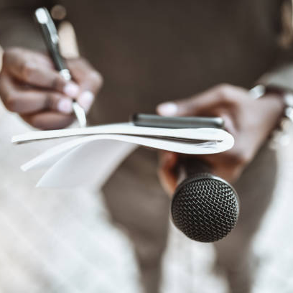
Today’s Media Landscape
Hint…it’s more than just newspapers and TV ☺

Slide 9
The 2025 Media Landscape
Traditional
Digital
Legacy newspapers
Star Tribune, Pioneer Press
Small-scale or niche publications
TV
Radio
Magazines
Online news outlets
Blogs
Podcasts
Social Media
Newsletters

Slide 10
The 2025 Media Landscape
How Journalists Work
Deadlines – “day of” vs. long-term
Sourcing – ideas, confirming information, subject matter experts (SMEs)
Story angle – What is the story about? What is your connection to the story?

Slide 11
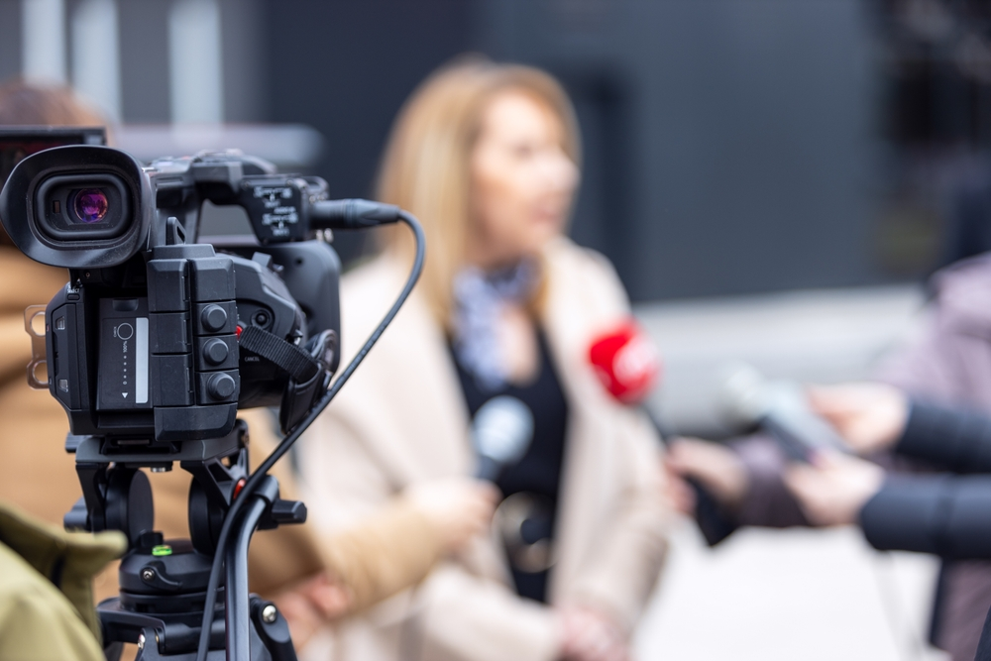
The 2025 Media Landscape
Media Trends
Fact-Checking
Live Interviews
Viral Clips & Interviews

Slide 12

Your Key Messages
AKA What am I going to say??????

Slide 13
Crafting & Controlling Your Messages
Key Message Development
Why are you running for office?
What are the issues you are most passionate about?
Why should people vote for you?
Message Pillars – 3-4 supporting themes and issues
Bridging Techniques – how to stay on message while answering the interviewer’s questions
Speaking in soundbites: importance and examples

Slide 14

Best Practices for Media Interviews

Slide 15
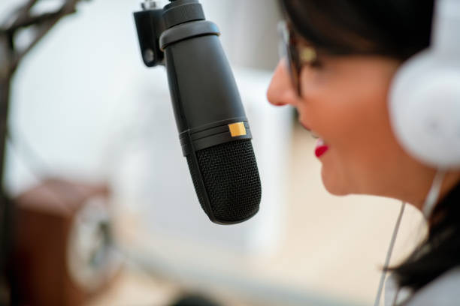
Preparing for Different Media Formats
Press Interviews (print and online)
TV appearances (live and recorded)
Radio and podcast interviews
Debates and forums
Social media engagement and livestreams

Slide 16
Make Sure You Know…
Media outlet name/format
Subject of the interview (what is the story about?)
How the interview will be conducted (in person, Zoom/Teams, over the phone)
Date/time/location of interview
Live or pre-recorded?
In studio, remote, or in the field?

Slide 17

Handling Difficult Questions
Stay calm under pressure
Be honest and authentic
Bridge or Pivot techniques: refer or redirect back to your key message
Remember: “No Comment” is a comment

Slide 18
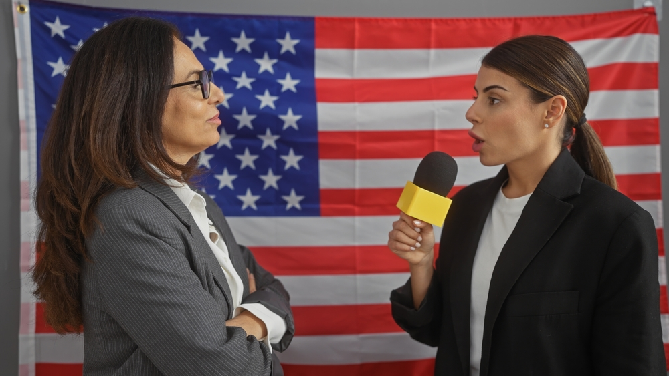
Mastering the Delivery
Voice: Tone, Pace, Clarity
Nonverbal Cues: Eye Contact, Posture, Gestures
Clothing: Dress for the Interview
Presence: Overcoming Pre-Interview Nerves

Slide 19
Do’s and Don’t’s

Slide 20
10 Do’s for a Media Interview
DO Know Your Key Messages
DO Practice Out Loud
DO Stay on Message
DO Research the Interviewer and Media Outlet
DO Dress for the Interview
DO Control Your Body Language
DO Speak Clearly and Concisely
DO Prepare for Tough Questions
DO Stay Calm and Respectful
DO End Strong

Slide 21
10 Don’t’s for a Media Interview
DON’T Wing It
DON’T Go Far Off Message
DON’T Overuse Talking Points
DON’T Say “No Comment”
DON’T Get Defensive or Combative
DON’T Lie, Exaggerate or Speculate
DON’T Forget – the Microphone or Recorder is Always On (aka the “Hot Mic”)
DON’T Ignore the Visuals
DON’T Talk Too Fast or Monopolize the Interview
DON’T Dodge Every Tough Question

Slide 22
OK – a few more “Don’t’s”
DON’T ask for a full list of questions ahead of the interview
DON’T ask to see the reporter’s story before it is published or airs
DON’T let your guard down
DON’T speak off the record without a clear agreement

Slide 23
Positive Media Relationships
Be Accessible and Responsive
Respect Reporter / Editor Deadlines
Be Honest and Transparent
Develop Personal Rapport
Provide Useful, Clear Information
Treat All Media Members with Respect
Don’t Overreact to Criticism
Be Strategic, but Fair About Exclusives
Follow Up and Say “Thank You”
Be Consistent

Slide 24
Questions & Answers

Slide 25
Thank you!
Amanda Theisen
651-206-2569
amanda.theisen@sunrisebanks.com
LinkedIn: www.linkedin.com/actheisen

